Slide 1
LUNG CANCER
Department of Oncology
Wroclaw Medical University
Dominika Zielecka-Dębska, MD; Katarzyna Konat, MD;
Krystian Lichoń, MD.

Slide 2
Epidemiology
Lung cancer in Poland in 2013:
 | New cases | Deaths
Men | 14609 | 15981
Women | 6915 | 6647

Slide 3
Lung cancer in Poland in 2013 (men)

Slide 4
Lung cancer in Poland in 2013 (women)

Slide 5
Screening
Low-dose CT scans for high-risk group:
Current or former smoker with a 30 or more pack-year smoking history
55-74 years of age
No evidence of lung cancer
Decreased the mortality rate from lung cancer by 20% (NLST).

Slide 6
Symptoms
Cough,
Dyspnoea,
Chest pain,
Hemoptysis,
Hoarseness,
Superior vena cava syndrome,
Horner's syndrome,
Superior sulcus tumor triad,
Dysphagia,
Pleural effusion,
Shoulder pain,
Postobstructive pneumonia.
Weight loss,
Weakness,
Arthralgia,
Increased body temperature,
Paresthesia,
Thrombosis,
Paraneoplastic syndromes (hypercalcemia, hypertrophic pulmonary osteoarthropathy, gynecomastia, VIP diarrhea).

Slide 7

Risk factors
Smoking tabacco,
disease history (eg. COPD),
previous cancer history,
family history of lung cancer,
exposure to radon, arsenic, chromium, asbestos, nickel, cadmium, beryllium, silica and diesel fumes.

Slide 8
5A’s framework – smoking cessation
Ask
Advice
Assess
Assist
Arrange

Slide 9
Histological types
1. Non-small cell lung cancer
Adenocarcinoma (40%)
2. Small cell lung cancer (15%)
Squamous cell carcinoma (30%)
Large cell carcinoma (10%)
Carcinoid tumors (rare)

Slide 10
Biology – non small cell lung cancer
Adenocarcinoma – tends to be peripherally located with high propensity to metastasize.
Squamous cell carcinoma – usually centrally located with lower propensity for brain metastasis.
Large cell carcinoma – peripherally located. High propensity to metastasize, especially to brain.
Carcinoid tumors – typical carcinoids rarely metastasize and are not associated with smoking, atypical carcinoids more frequentlymetastasize, have poorer prognosis and are associated with smoking.

Slide 11
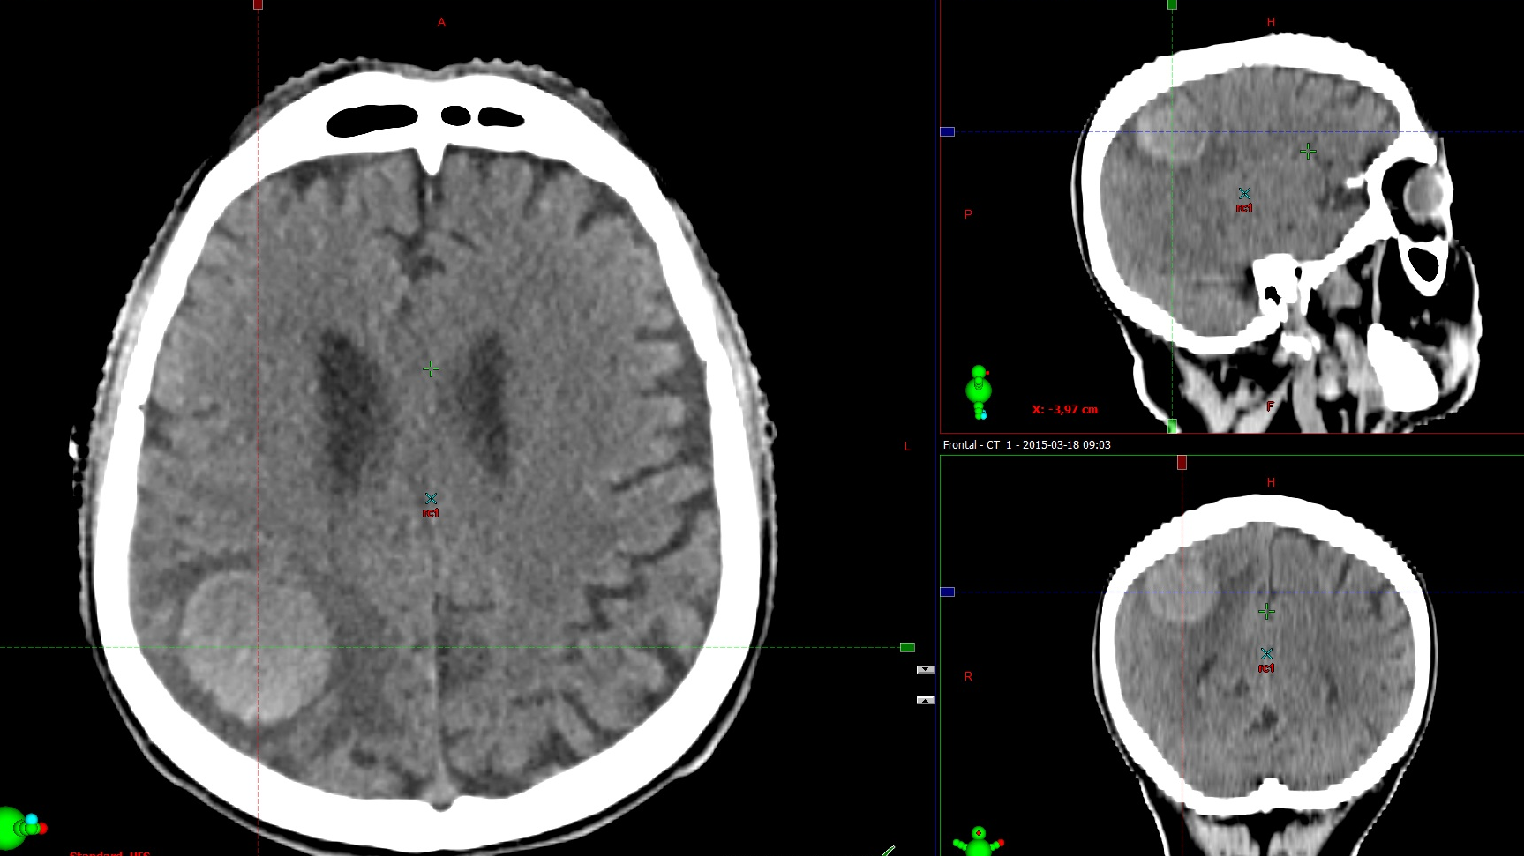
NSCLC – brain metastasis

Slide 12
Biology – small cell lung cancer
> 95% of cases are associated with a history of tabacco exposure.
Rapidly growing.
10-15% patients present with brain metastases and two year incidence after chemoradiotherapy is 50-80%.
The most common solid tumor associated with paraneoplastic syndromes.

Slide 13
Evaluation (1)
History (age, smoking history, previous cancer history, family history, occupational exposures, other lung disease, exposure to infectious agents, risk factors or history suggestive of infection, comorbidities),
Physical examination (include performance status and weight loss),
Chest X-ray in two projections (persistent cough, recurrent pneumonia, hemoptysis),
Chest CT with contrast (gold standard after chest X-ray),
Upper abdomen CT or USG (liver or adrenal metastasis),
Bronchoscopy (always in the presence of hemoptysis),
Pathologic evaluation (thoracentesis for pleural effusion, sputum cytology, bronchoscopy with biopsy or bronchial swab for central tumors, CT-guided biopsy for peripheral lesions, fine-needle aspiration, videothoracoscopy, mediastinoscopy, thoracotomy),

Slide 14
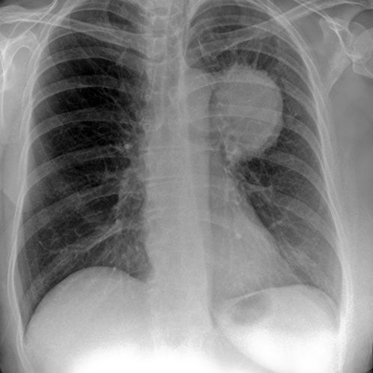
Radiograph – lung cancer

Slide 15
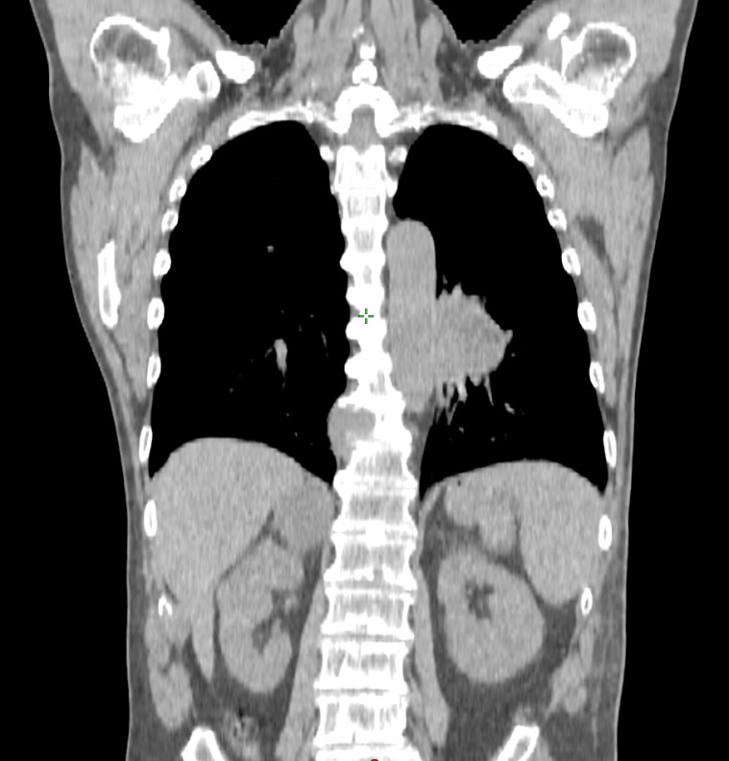
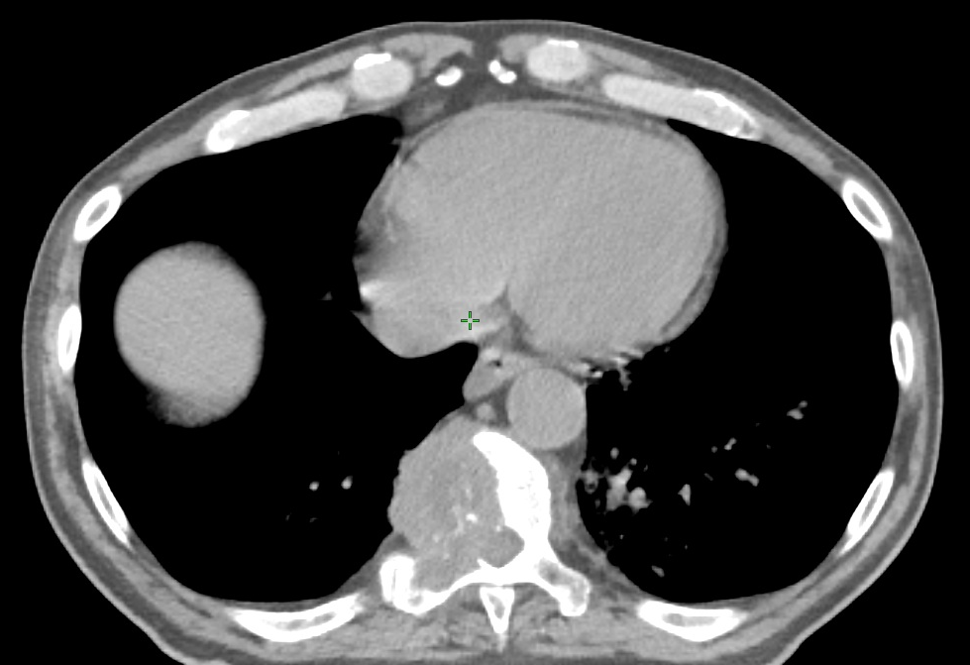
Examples of metastases in NSCLC
Spine and adrenal gland
Spine (note spinal cord compression)

Slide 16
Evaluation (2)
Complete blood count, platelets,
Chemistry profile (blood urea nitrogen, creatinine, liver function tests, alkaline phosphatase, LDH),
Pulmonary function tests (presurgical and preradiotherapy evaluation),
FDG PET/CT scan,
CT or MRI with contrast of brain (for non-squamous lung cancer with involved lymph nodes, all stage III-IV or for neurologic symptoms),
MRI of thoracic inlet for superior sulcus tumors.

Slide 17
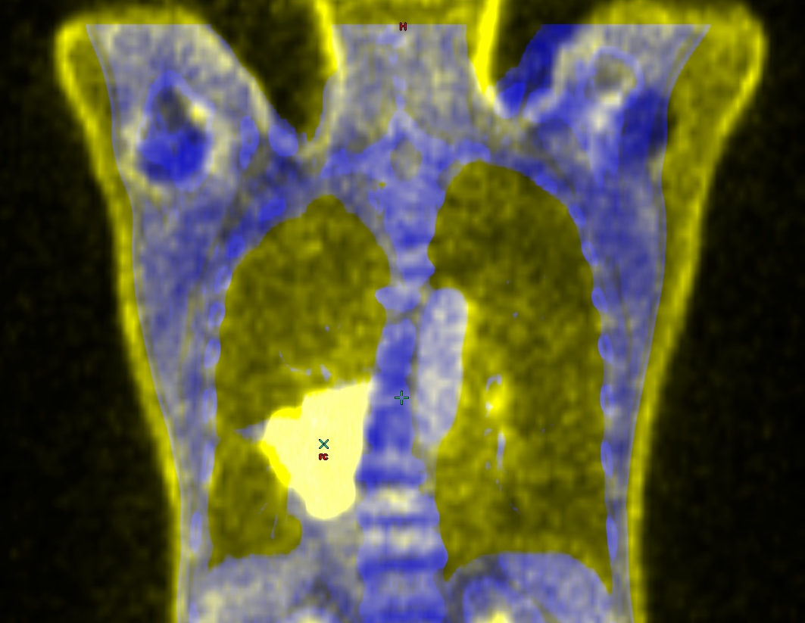
FDG PET-CT

Slide 18
Prognostic factors
Stage of the disease,
Performance status (KPS, WHO),
Weight loss (> 10% over 6 months),
Lactate dehydrogenase (SCLC),
Pleural effusion,
EGFR and KRAS mutations, ALK gene rearrangements (adenocarcinoma and NSCLC NOS).

Slide 19
Karnofsky Performance Status
100
Normal; no complaints, no evidence of disease
90
Able to carry on normal activity; minor signs or symptoms of disease
80
Normal activity with effort, some signs or symptoms of disease
Dead
70
Cares for self; unable to carry on normal activity or to do active work
60
Requires occasional assistance, but is able to care for most of his needs
50
Requires considerable assistance and frequent medical care
40
Disabled; requires special care and assistance
30
Severely disabled; hospital admission is indicated, but deast is not imminent
20
Very sick; hospital admission necessary; active support treatment necessary
10
Moribund; fatal process progressing rapidly
0

Slide 20
Lung cancer TNM
T – tumor size, location and invasion of adjacent structures,
N – location of metastases to regional lymph nodes,
M – presence of distant metastases.

Slide 21
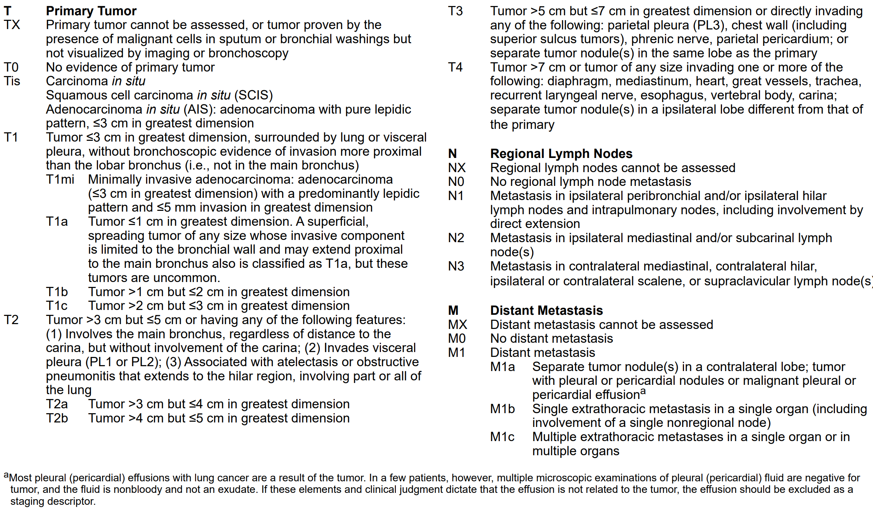
TNM staging – NSCLC and SCLC

Slide 22
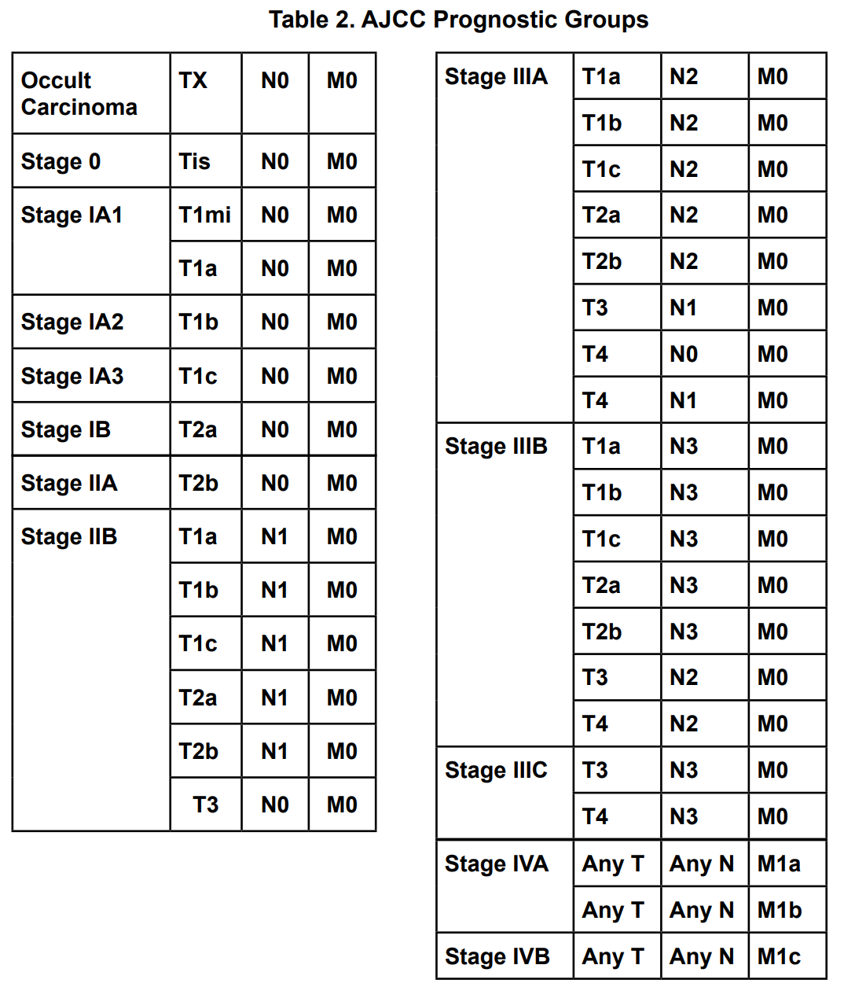
Clinical staging – NSCLC and SCLC

Slide 23
LD and ED in small cell lung cancer
Limidet-stage disease (LD)
Extensive-stage disease (ED)
Stage I-III (T any, N any, M0) that can be safely treated with definitive radiation doses. Excludes T3-4 due to multiple lung nodules that are too extensive or have tumor/nodal volume that is too large to be encompased in a tolerable radiation plan.
Stage IV (T any, N any, M1a/b) or T3-4 due to multiple lung nodules that are too extensive or have tumor/nodal volume that is too large to be encompased in a tolerable radiation plan.

Slide 24
Lung cancer treatment
Treatment of lung cancer depends on numerous factors (NSCLC/SCLC, clinical stage, performance status, comorbidities) and the decision should always be done by multidisciplinary team consisting of experienced thoracic surgeon, radiation oncologist, clinical oncologist, pathologist, pulmonologist and radiologist.

Slide 25
Non small cell lung cancer - treatment

Slide 26
Surgery – non small cell lung cancer
Treatment of choice for patients with stage I, II and selected IIIA (without N2) is surgery.
video assisted thoracic surgery (VATS) and minimally invasive surgery (robotic-assisted surgery),
sublobar resections: segmentectomy or wedge resection,
lobectomy and sleeve lobectomy with regional lymph node resection,
pneumonectomy with regional lymph node resection.
The objective is always to achive negative margin! (No role of cytoreductive surgery in definitive treatment).
For patients with IIIA N2 disease and good response to neoadjuvant chemotherapy surgery may be considered.

Slide 27
Chemotherapy – non small cell lung cancer
concurrent with radiation therapy for IIIA and IIIB stage disease (or sequential before radiotherapy),
concurrent with radiotherapy for positive surgical margin (or sequential before radiotherapy),
before surgery for selected IIIA N2 disease,
as palliative treatment.
Platinum-based chemotherapy is the most effective.
Examples of chemotherapy regimens for NSCLC:
Cisplatin + etoposide/ vinblastine/ vinorelbine/ gemcitabine/ docetaxel/ pemetrexed,
Carboplatin + pemetrexed/ paclitaxel.

Slide 28
Radiotherapy – non small cell lung cancer
Stereotactic body radiation therapy (SABR): stage I and selected node negative stage IIA for patients who are medically inoperable or who refuse to have surgery.
Postoperative radiation therapy (PORT) with or after postoperative chemotherapy: for patients with positive surgical margins and postoperative N2 disease.
Thoracic radiotherapy concurrent with chemotherapy (or sequential after chemotherapy): radical treatment for stages II-III.
Definitive local therapy to isolated or limited metastatic sites (brain, lung, adrenal gland): for well-selected patients with good performance status who have also received radical therapy to the intrathoracic disease,
Palliation or prevention of symptoms (pain, bleeding, obstruction).

Slide 29
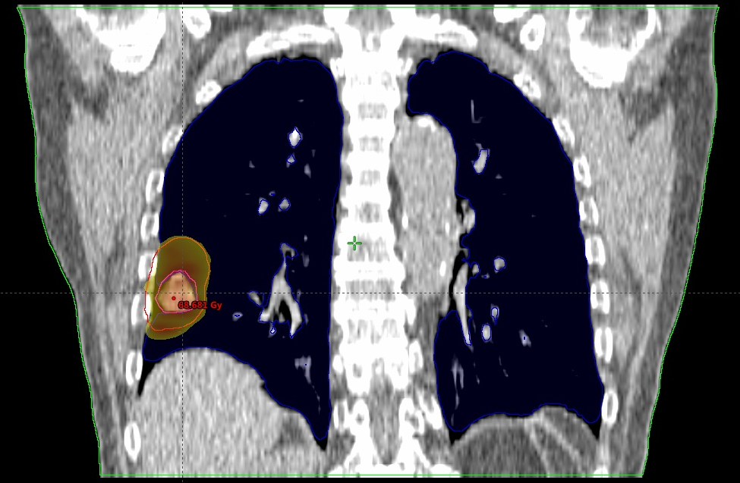
SABR for cT1, cN0, cM0, NSCLC tumor in an elderly patient

Slide 30
Targeted therapies
Targeted therapy uses agents targeting various molecular pathways.
For the treatment of advanced NSCLC specific targeted therapies are available:
bevacizumab – recombinant monoclonal antibody that blocks the vascular endothelial growth factor (VEGF),
erlotinib, gefitinib, afatinib – small molecule thyrosine kinase inhibitors of epidermal growth factor receptors (EGFR),
crizotinib – small molecule inhibitor that shows benefit in a subset of NSCLC that is characterized by the EML4-ALK fusion oncogene (found in some relatively young, never or light smokers with adenocarcinoma),
ceritinib – small molecule inhibitor that targets ALK and IGF-1,
alectinib – small molecule inhibitor that targets ALK and RET.

Slide 31
Small cell lung cancer - treatment

Slide 32
Surgery – small cell lung cancer
Surgery is rarely used for SCLC.
Patients with SCLC that is clinical stage I (T1-2, N0) after standard staging evaluation and ruling out occult nodal disease (mediastinoscopy or other surgical mediastinal staging) may be considered for surgical resection: lobectomy with mediastinal nodal dissection or sampling.
Postoperative N0 → chemotherapy,
Postoperative N(+) → chemoradiotherapy.

Slide 33
Chemotherapy - small cell lung cancer
For all patients with SCLC, chemotherapy is an essential component of appropriate treatment:
after surgical resection,
with thoracic radiotherapy in LD,
in ED (alone or combined with radiotherapy).
Examples of chemotherapy regimens for SCLC:
cisplatin and etoposide (LD, ED),
carboplatin and etoposide (LD, ED),
cisplatin and irinotecan (ED),
carboplatin and irinotecan (ED).

Slide 34
Radiotherapy – small cell lung cancer
Radiotherapy is often used for the treatment od SCLC:
Thoracic radiotherapy with concurrent chemotherapy in LD (or sequential after chemotherapy) as radical treatment.
Thoracic radiotherapy after chemotherapy in ED – consolidative treatment for selected patients.
Prophylactic cranial irradiation (PCI) – in patients with LD who have a good response to initial therapy and in patients with ED that has responded to systemic therapy.
Whole brain radiation therapy (WBRT) – for brain metastases.
Palliative treatment.

Slide 35
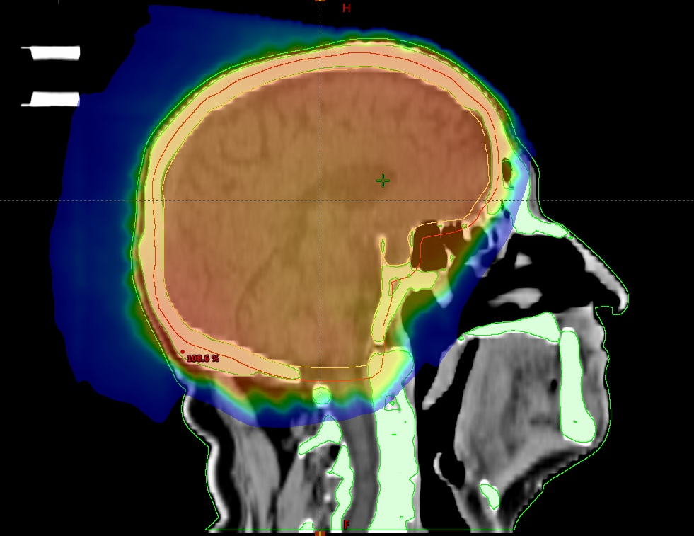
Whole brain radiation therapy

Slide 36
Summary
Lung cancer is very common and it is the leading cause of cancer deaths.
Symptoms are nonspecific.
The most important risk factor in smoking tabacco.
Two different types of lung cancer are non small cell lung cancer (NSCLC) and small cell lung cancer (SCLC).
Treatment may include surgery, chemotherapy, radiotherapy, targeted therapies and best supportive care depending on cancer type, disease stage, patient’s performance status and other factors.

Slide 37
Literature
Kordek R.: Onkologia. Podręcznik dla studentów i lekarzy, wydanie trzecie. Via Medica, Gdańsk 2007.
Hansen E., Roach III M.: Handbook of Evidence-Based Radiatiom Oncology, second edition, Springer 2010.
Krzakowski M., Jassem J.: Nowotwory płuca i opłucnej oraz śródpiersia, w Onkologia w Praktyce Klinicznej - Zalecenia postępowania diagnostyczno-terapeutycznego w nowotworach złośliwych 2013 rok, tom I, Via Mecica, Gdańsk 2013.
National Comprehensive Cancer Network, NCCN Guidelines for treatment of cancer by site, Non-small lung cancer and Small call lung cancer – access from 29.09.2016.
Wojciechowska Urszula, Didkowska Joanna. Zachorowania i zgony na nowotwory złośliwe w Polsce. Krajowy Rejestr Nowotworów, Centrum Onkologii - Instytut im. Marii Skłodowskiej - Curie. Dostępne na stronie http://onkologia.org.pl/raporty/ dostęp z dnia 29.09.2016.

