Slide 1
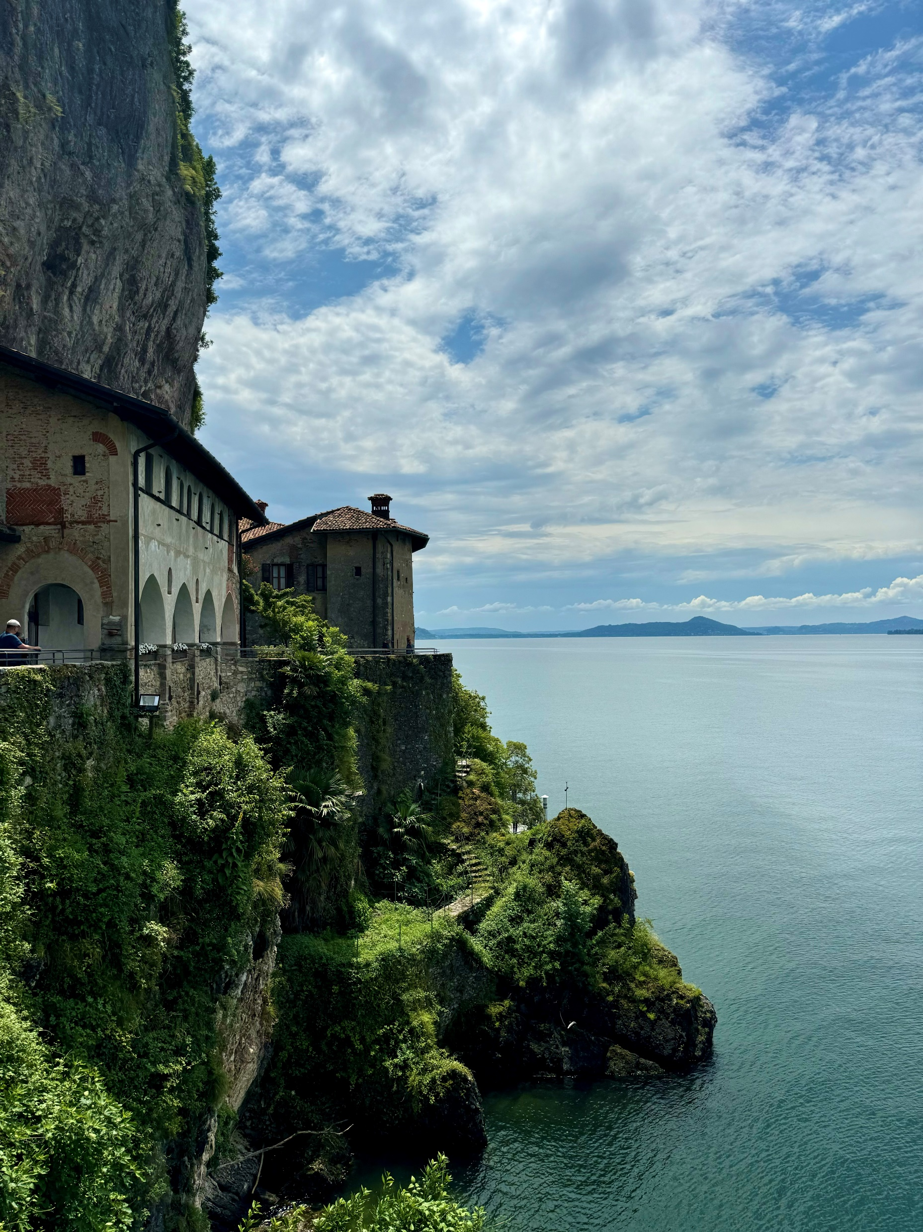

Information meeting ERASMUS+
placements 2024/2025 (during and after studies)
studies 2025/2026
14.11.2024
Photo: Anita Froń

Slide 2

STUDENTS – TYPES OF MOBILITIES:
SIMILAR RULES, DIFFERENT SCHEDULE
Rules of recruitment according to Regulations no 17/XV R/2019 from 27.02.2019 with changes:
https://www.umw.edu.pl/pl/erasmus/erasmus-informacje-ogolne
https://www.umw.edu.pl/sites/default/files/2022-10/Zasady_Kwalifikacji_STUDIA_EN%282%29.pdf
https://www.umw.edu.pl/sites/default/files/2022-10/Zasady_Kwalifikacji_praktyki_EN%282%29.pdf
Deadlines:
Studies - until 15 March
Traineeships during studies and after studies – until 30 November
BIP – continuous recruitment
long-term mobility studies/traineeships from 2 to 12 months: physical mobility (minimum 2 months) and optional virtual part (min./max. period not defined)
short-term mobility studies/traineeships (5-30 days of physical mobility) combined with obligatory (in case of PhD students - opcional) virtual part (min./max. period not defined)
BIP (Blended Intensive Programmes): short-term mobility studies (5-30 days of physical mobility) combined with obligatory virtual part (min./max. period not defined) - minimum 3 ECTS

Slide 3

WHERE YOU CAN GO:
https://www.umw.edu.pl/pl/erasmus/uczelnie-partnerskie
https://www.umw.edu.pl/sites/default/files/2024-11/Praktyki%202024%20na%20stron%C4%99.xls
ATTENTION! When choosing a place pay attention to the faculty.
ATTENTION! Student can not ask about an extra place in the institution which has the agreement with UMW. It is not a place found by the student.
studies
place – university which has the agreement with UMW for certain field of studies
traineeships
place – institution which has the agreement with UMW
place found by the student (suggested)

Slide 4

NOVELTIES IN THE ERASMUS+ PROGRAMME 2021-2027– INTERNATIONAL MOBILITIES
International mobility:
possibility to go to countries outside the European Union (UE).
- programme countries (UE + Lichtenstein, Luxemburg, Norway, Turkey, Serbia, Northern Macedonia)
- partner countries (outside UE)
Scholarship (rate per month) depends on country group; One rate in case of partner countries: https://www.umw.edu.pl/sites/default/files/2024-04/Zasady%20finasowania%202024-2025.pdf
In case of mobilities to partner countries receiving side must be the university and there is supposed to be the agreement signed
Switzerland, Great Britain (scholarship the same as in case of programme countries)
20% of the budget

Slide 5
CONDITIONS:
completing I year of studies (applies to studies)
minimum avarage grade of entire period of studies: 3,0
knowledge of the language of instruction of receiving university (or excellent knowledge of English in case a language of instruction is English)
students of last year can participate in the programme (medicine: studies – NO, traineeships: YES)
student can go on mobility several times:
- max 12 months per each cycle of studies
- max 24 months per one-cycle of studies
selected student might benefit from the scholarship providing a year of studies prior to departure is completed
in case of recent graduates the student must be selected at the last year of studies
in case of recent graduates - the duration of a traineeship by recent graduates counts towards the 12 months maximum of the cycle during which they apply for the traineeship
in case of multiple mobility a one year break between the mobilities is required (applies to studies)

Slide 6
APPLICATIONS ON-LINE AVAILABLE AT FOLLOWING WEBSITES:
https://www.umw.edu.pl/pl/erasmus/wyjazdy-na-praktyki
https://www.umw.edu.pl/pl/erasmus/wyjazdy-na-studia
https://erasmus-outgoing.umw.edu.pl/
za
CREATE ACCOUNT
STUDIES
STEP 1
Personal data
STEP 2 ATTACH DOCUMENTS
STEP 2 SIGN UP FOR THE LANGUAGE EXAM
Choosing places:
TRAINEESHIPS during studies and after studies
starting form academic year 2020/2021 students do not have to attach certificates of average grade of entire period of studies prior to departure (information is provided by dean’s office)
letter of intent in case of traineeships (place found by the student; might be sent later)
certificate of disability and/or maintenance scholarship if applies
certificates and documents regarding extra criterias of selection
until 15 March
until 30 November
in case of mobilities to Germany, Austria – German, to France – French, to other countries – English
students who go to the country where the language of instruction is their mother tongue do not have to pass a language exam and get 5
grade of the language exam might be the same as the one obtained during a previous recruitment providing there was not more than 9 months break
in exceptional cases (traineeships) is possible to go to Germany, Austria or France and pass an English exam providing host side accepts this (written acceptance)
traineeships: institution/university from the list and/or place found yourself
studies: university from the list
Confirm and submit

Slide 7


THE BASE OF RECRUITMENT OF THE STUDENT IS THE NUMBER OF POINTS AWARDED FOR :
average grade of entire period of studies prior to departure
language exam (carried out by the Department of Languages)
certified documents of criterias of recruitment
On the basis of submitted documents the International Relations Office (Erasmus Office) prepares the list of applicants willing to go abroad according to the awarded points
In case of the same number of points awarded the order is made by avarage grade of entire period of studies prior to departure

Slide 8


THE FOLLOWING RULES APPLY TO CALCULATION OF POINTS:
avarage grade of entire period of studies
    points awarded in language exam
Exam – ocena Awarded points
bardzo dobry (5) 4
ponad dobry (4,5) 3
dobry (4) 2
dość dobry (3,5) 1
Attention: grade of language of instruction (French, German) in case of mobilities of studies can not be lower than 3,5
students
avarage grade | awarded points
3.00 – 3.50 | 6
3.51 – 3.75 | 7
3.76 – 4.00 | 8
4.01 – 4.25 | 9
4.26 – 4.50 | 10
4.51 – 4.75 | 11
4.76 – 5.00 | 12

Slide 9

EXTRA CRITERIAS OF SELECTION
active participation in the Students’ Science Associations – minimum 1 year (no matter how many associations a student is
a member of) – 1 point
research works presented in conferences of the Students’ Science Associations or published in handouts of that conferences (no matter how many research works were presented or published) – 1 point
research works presented or published in conferences or published in scientific journals (no matter how many research works were presented or published) – 1 point
awards given to a student during the studies – Ministry, Rector’s (except for Rector’s scholarship) or University awards (no matter how many) – 1 point
foreign internships, foreign vocational courses or workshops (no matter how many) – 1 point
work for student’s life (confirmed by the organisation and university authorities) – 1 point
work for the Erasmus+ programme at the home university - 1 point

Slide 10

TIMETABLE OF RECRUITMENT OF STUDENTS:
MEETINGS WILL TAKE PLACE AT THE PLATFORM MS TEAMS
STUDIES
submitting application on-line and additional documents - until 15 March,
TRAINEESHIP during studies and after studies
submitting application on-line and additional documents - until 30 November
language examination - until 30 March,
interview with a relevant board of recruitment – until 15 April,
announcement of the result of the recruitment – until 20 April,
organisational meeting with the accepted students – until 25 April,
submitting documents to be sent to partner universities – until 10 May
language examination – until 15 December
interview with a relevant board of recruitment – until 15 January
announcement of the result of the recruitment – until 20 January
organisational meeting with the accepted students – until 25 January
submitting documents to be sent to partner universities – until 10 February

Slide 11

Financial conditions during a student’s stay abroad cover:
grant (either scientific or social) awarded by the student at the home university
extra funds for students with disability and those who receive maintenance scholarship
Green travel:
sustainable means of transport – increased lump sum for travel: https://www.umw.edu.pl/pl/erasmus/green-travel
Erasmus+ scholarship
travel costs (lump sum):
travel distance calculated based on the online calculator available at the website of the European Commission (EC):
https://erasmus-plus.ec.europa.eu/resources-and-tools/distance-calculator
Amounts of scholarship
- traineeships 2024/2025 – information at the website:
https://www.umw.edu.pl/sites/default/files/2024-04/Zasady%20finasowania%202024-2025.pdf
- studies 2025/2026 – no information yet
- free courses on-line (OLS platform – Online Language Support)
- refund of costs of language course (excluding English, French, and German) which takes place before the studies at partner universities start. The amount is agreed each year

Slide 12
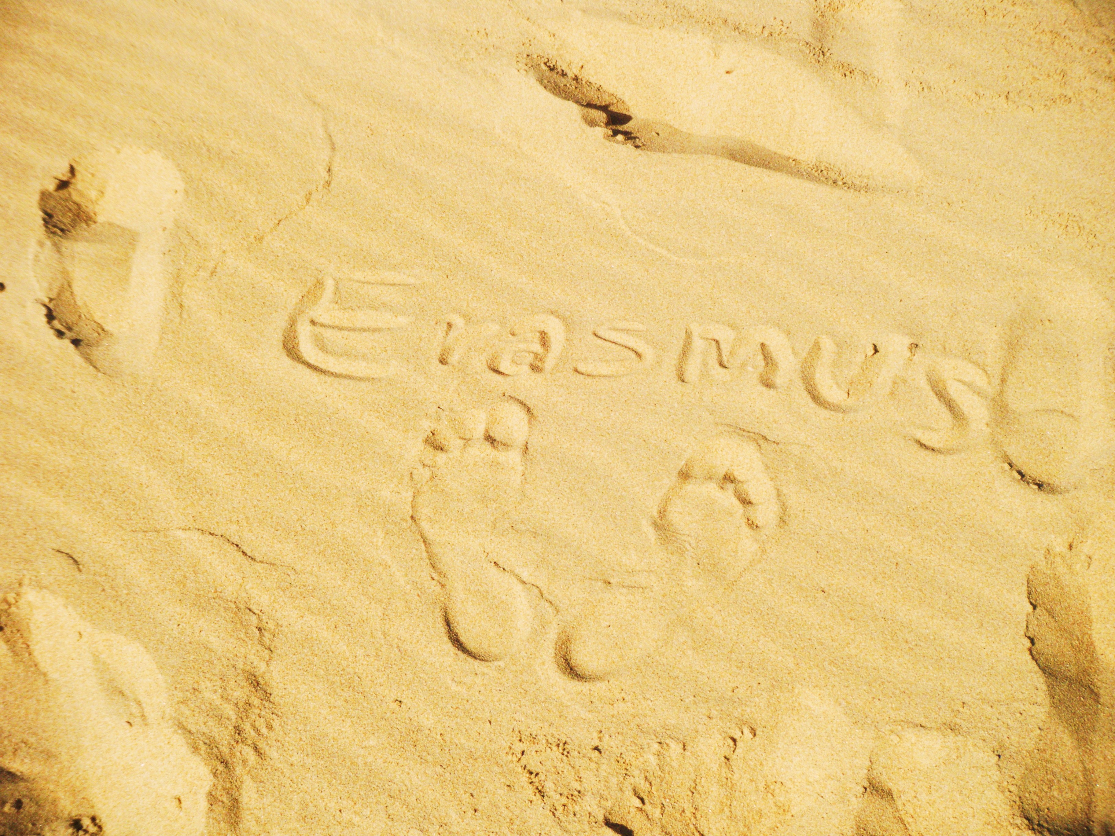
FACULTY OF MEDICINE
Tymoteusz Okupnik MSc - outgoing students
Zakład Fizjologii
ul. Chałubińskiego 10
50-368 Wrocław
tel. +48 71 784 14 28
e-mail: tymoteusz.okupnik@umw.edu.pl
Dr. Zygmunt Domagała - incoming students
Zakład Anatomii Prawidłowej
ul. Chałubińskiego 6a
50-368 Wrocław
tel. +48 71 784 13 31
e-mail: zygmunt.domagala@umw.edu.pl
Faculty of Dentistry
dr Irena Duś-Ilnicka
Zakład Periodontologii
ul. Krakowska 26
50-425 Wrocław
telefon: +48 71 784 03 81
e-mail: irena.dus-ilnicka@umw.edu.pl
Photo: Piotr Pabich
Notes:
12

Slide 13

CONTACT:
Institutional Coordinator
Outgoing students
Sława Ksenycz slawa.ksenycz@umw.edu.pl
Incoming students
Dominika Lucińska dominika.lucinska@umw.edu.pl
Sylwia Kołodziejska sylwia.kolodziejska@umw.edu.pl
Uniwersytet Medyczny im. Piastów Śląskich we Wrocławiu
International Relations Office
ul. T. Chałubińskiego 6a
50-368 Wrocław
tel: +48 71 784 16 85
https://www.umw.edu.pl/pl/erasmus/wykaz-koordynatorow

